Slide 1
CS 4350: Fundamentals of Software Engineering CS 5500: Foundations of Software Engineering Lesson 2.2 Introduction to UML
Jon Bell, John Boyland, Mitch Wand
Khoury College of Computer Sciences

Slide 2
Learning Objectives for this Lesson
By the end of this lesson you should be able to:
Read and write simple UML class diagrams
Illustrate some ways that UML class diagrams may be realized in code
Read and write simple UML sequence diagrams

Slide 3

Unified Modeling Language
UML is a general-purpose visual modeling language developed by an industry consortium in 1997.
Based on multiple prior visual modeling languages.
Goal was to have a single standard representation for a large number of SE tasks.
A large language: 13 different kinds of diagrams
Currently, UML is at version 2.5.1 (December 2017)
See UML.org and
https://www.omg.org/spec/UML/
3
Notes:
Booch Notation (Grady Booch, 1992)
OMT = "Object Modeling Technique" (Rumbaugh et al, around 1991)
OOSE = "Object-Oriented Software Engineering" (Ivar Jacobson, 1992)

Slide 4
UML in the context of this course
We are interested in UML as a human-to-human language.
So we expect your UML diagrams to "look like" UML diagrams, but we are not interested in every last detail of the notation.
We just want your diagrams to communicate the important things, with detail as necessary.

Slide 5
Most common diagram: the Class Diagram
Class Diagram: Which objects do we need?
Which are the features of these objects? (attributes, methods)
How can these objects be classified? (is-kind-of hierarchy, both via inheritance and interface)
What associations are there between the classes?
5

Slide 6
Class Diagrams
A Class is drawn as a three-part box containing:
class name (required)
list of attributes with names and types (optional)
list of methods with argument lists (optional)
Components with special roles may be annotated with "stereotypes", which are written with <<...>>.
Name
Attribute₁ : type₁
Attribute₂ : type₂
method₁ (signature) : type₁
method₂ (signature) : type₂
6

Slide 7
Attributes
The attributes of a class are roughly those members (or "instance variables" or "properties", depending on what language you are writing in) whose values are either
scalars ("simple" attributes)
arrays or lists of scalars ("multivalued" attributes)
simple structs (e.g. dates or names)
Class members whose values are full-fledged objects (of this or some other class) are usually represented in UML as relationships.
In TypeScript, functions are values, so for us an attribute could have a value that is a function. Your real boss may or may not agree.

Slide 8
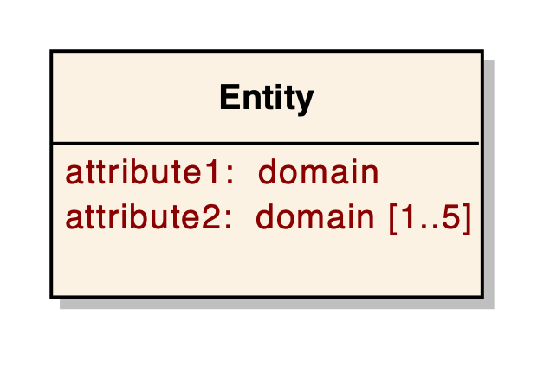
Attributes: Example
attribute1 is simple.
attribute2 is multivalued (there can be up to five values stored on attribute2)
domain is UML terminology for “type”
8

Slide 9
Relationships
UML has notations for 3 kinds of relationship between classes:
Most general relationship: association
Special cases:
Generalization
Aggregation
9
Notes:
Three structural relationships form the basis of the semantic network model on which entity-relationship models are based:
1. An entity is associated with another entity and the association contains important facts about the domain (the is-associated-with relationship). This is commonly called association.
2. An entity is built by combining attributes. This is commonly referred to as aggregation.
3. An entity represents a specialization or abstraction of another entity. This is commonly referred to as the generalization and specialization or inheritance abstraction.

Slide 10
Relationship #1: Association
An association is a simple semantic relationship between two objects that indicates a link or dependency between them.
Examples:
a portfolio is associated with an investor
every sale is associated with the sales representatives that worked on the sale
every student is associated with a transcript
Associations can be directed, meaning there is a relationship from one object to another, or bi-directional, meaning the relationship works both ways.
Relationships may be annotated with descriptions.
An association may be implemented in several possible ways.
10

Slide 11

Properties of Associations: Navigability
Associations can be navigable, meaning that from one object, you can find the associated object.
A navigable association is notated with an arrow to indicate the direction in which it flows.
An association with no arrows means that navigability is unspecified.
from A2, you can get to the associated object of B2

Slide 12
Properties of Associations: Cardinality (or Multiplicity)
The relationship between two entities has an associated cardinality or multiplicity
multiplicity is expressed with specific numbers or ranges,
e.g.: 1:1..2 or 1:1..N
Examples:
A student is associated with exactly one transcript (1:1)
One student, one transcript.
Every course is taught by a professor, but a professor must teach at least one course (1:1..*)
One course, one professor. One professor, one or more courses.
An address may have a zip code (1:0..1)
One address, zero or one zip code
12

Slide 13
Notation for Cardinality in Associations
Instructor
teaches ►
Course
Any given instructor teaches 1 course. Any given course is associated with one instructor.
1
1
Instructor
teaches ►
Course
Any given instructor teaches at least 1 and up to 10 courses. Any given course is associated with one instructor.
1
1..10
Instructor
teaches ►
Course
Any given instructor teaches 1 or more courses. Any given course is associated with one instructor.
1
1..*
Note: the solid triangle indicates how a human should interpret the relationship ("Instructor teaches Course"). It does not indicate navigability (from an instructor, can you find the list of courses they teach?)
Instructor
teaches ►
Course
If no cardinality is specified, it defaults to 1.
1..*
13

Slide 14
Full Association Specification
Name Label
The UML folks tried to think of everything you could possibly say about an association. Like much about SE, you only need to memorize the parts you need.
Role Name
Constraint
on role
Student
«key» studentID: text
Participant
attends
major: text
courseNo
{prequisites met}
matrStatus: Boolean = false
0..*
0..6
Class
{ordered}
Key/Qualifier
studentID
Constraint on
relationship
Course
Multiplicity
(* means unbound)
«key» courseNo: text
title: text
register(studentID) : void
14
Notes:
An association can have textual labels indicating its name, role, constraints, and multiplicity and can be further qualified with the use of a stereotype. The multiplicity of an association indicates how many instances of one class participate in the relationship with a single instance of another class. Thus, in the following slide, a particular student object will be related to several course objects, and a particular course object will be related to several student objects.
An association can be implemented through means other than, for example, pointers. Where the linkage is through some kind of key or identification number, that can be notated as in the diagram above (courseNo and ssn). In fact, any attribute that represents a key should be deleted as an attribute and instead an association with the class should be created. The key, of course, will become an implementation level field of the implemented class, but is not one of its attributes. For example, for all order we'll track the employee who placed the order by storing the employee's ID. However, the correct representation should be:

Slide 15
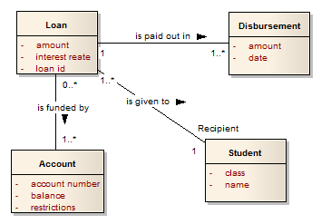
Associations should reflect something about the real world
Partial Translation:
We have discovered that a loan can be paid out in multiple disbursements. There does not appear to be any limit to the number of disbursements. In addition, each loan is given to a single student. Apparently, students cannot share loans.
15

Slide 16
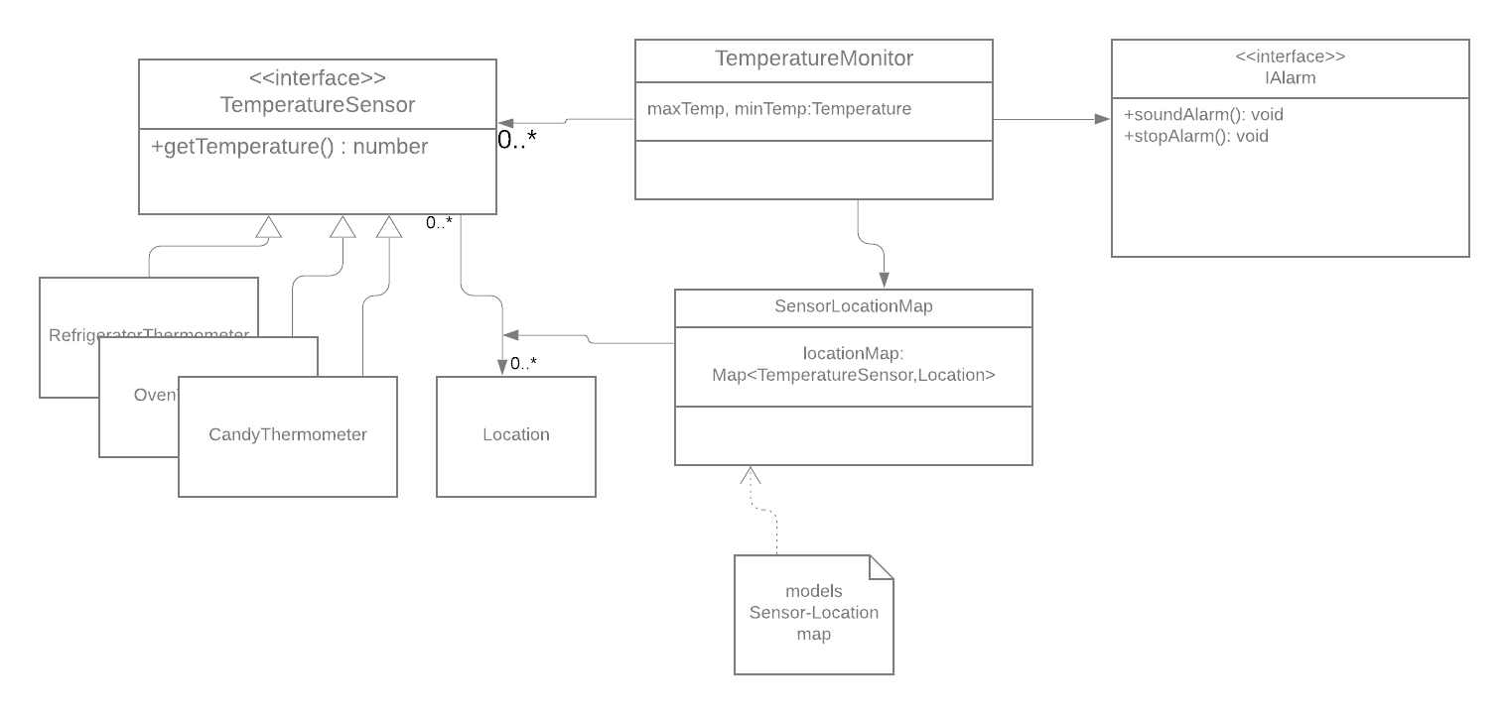
What world are we modeling?
Sometimes the world we are modeling is not the real world, but the world of entities in our program
Discussion Question: Which parts of this chart represent things in the real world, and which parts represent things that only live in our computers?
16

Slide 17
Relationship #2: Generalization
Generalization is a grouping of entities based on common attributes.
describes an is-a-kind-of relationship between entities
17

Slide 18
Generalization
more general as you move up
more specific as you move down
more specific may inherit attributes and operations from the more general
may specialize attributes and operations
Northeastern Person
Employee
Student
Faculty
Graduate
Staff
Undergraduate
18

Slide 19
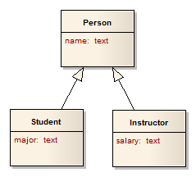
Generalization in UML
Person
name: text
Student
Instructor
major: text
salary: text
These are equivalent
19

Slide 20
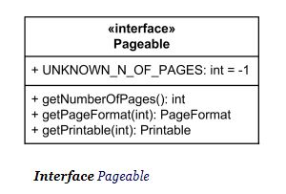
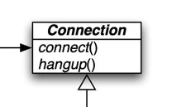
Interfaces and "implements"
In UML, the "implements" relation is generally considered to be a form of generalization.
An interface is typically notated like a class, but with the stereotype <<interface>>. Alternatively, the name of the interface may be given in italics.
The "implements" relationship may be notated with a dotted or dashed line, or by an open-headed arrow.

Slide 21

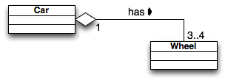
Relationship #3: Aggregation
A car has 3–4 wheels
The solid arrow indicates the way we should read "has" (a car "has" wheels, not wheels "has" a car).
Discussion Question: What should the navigability of this association be? Should we be able to get from a Car to the Wheels that it has? Should we be able to get from Wheel to Car?
21

Slide 22
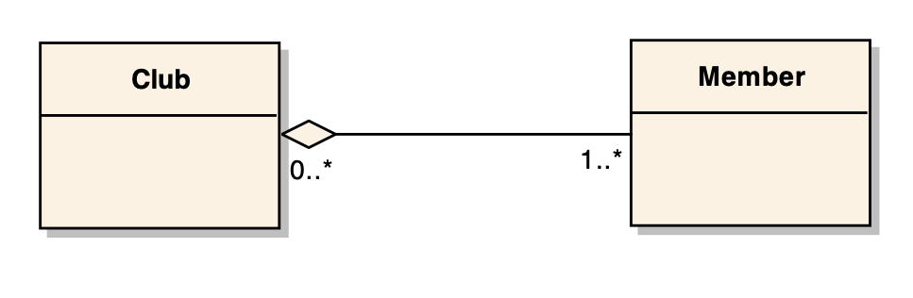
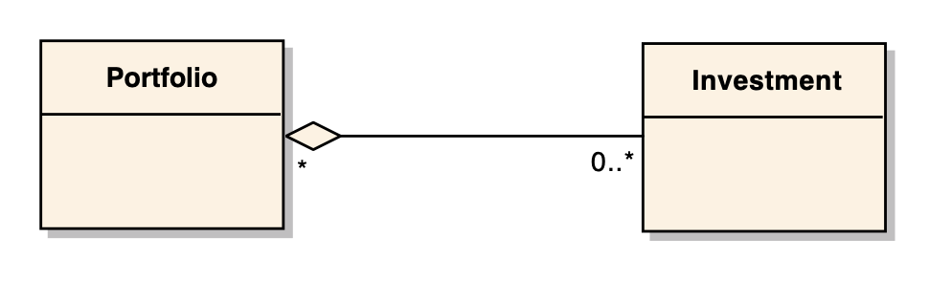
Aggregation: Definition
Aggregation is an association that means a “whole/part” or “containment” relationship.
The distinction between association and aggregation is not always clear.
Don't stress about this: If in doubt, notate the relationship as a simple association.
What relation is portrayed in each of these diagrams? What should its navigability be?
22
Notes:
While the distinction between association and aggregation is not always clear, it is important that members of a project team agree about the use of the term. In general, aggregation is reserved for associations with a strict hierarchy.
Composition is a still stronger hierarchical association. Composition implies that the contained object’s lifetime is controlled by the containing object. Thus a car-engine association is aggregation, because the engine might be removed from one car and placed in another. The car-paint association is composition, because the paint does not have an independent lifetime.
By contrast, the car-garage association in neither aggregation nor composition. Neither can be considered part of the other in any sense.

Slide 23
A second kind of UML Diagram: Sequence Diagrams
Shows the flow between elements of a system (the messaging sequence)
Classes (instances of classes)
Components
Subsystems
Actors
Time is explicitly shown and flows from top to bottom
23

Slide 24
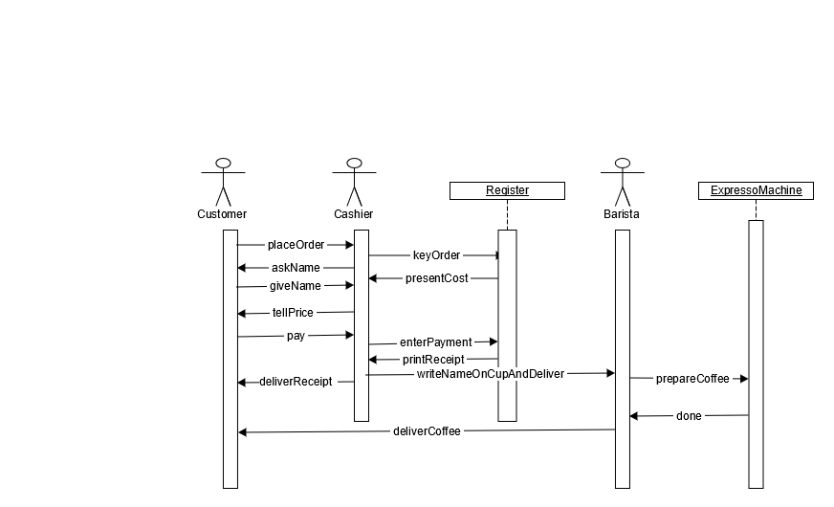
Example
t

Slide 25
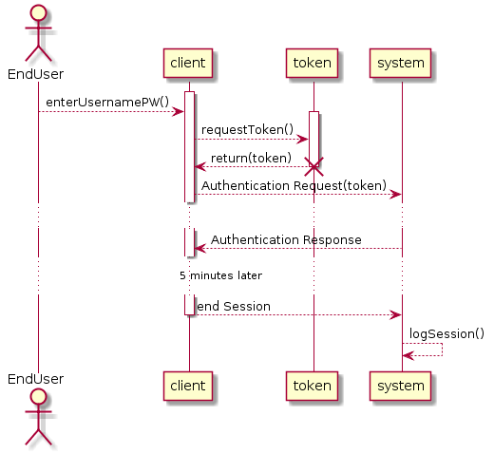
Another Example
Activate Entity
Destroy Entity
t
Deactivate Entity
25

Slide 26
Review: Learning Objectives for this Lesson
You should now be able to:
Explain what it means to document a design
Describe the importance of having a shared vocabulary
for teams,
for communicating with management
for dealing with clients
Illustrate the basics of CRC cards

Slide 27
Next steps...
In our next lesson, we'll talk about UML, a far more elaborate system for documenting designs

